Slide 1
New Mzamomtsha
Miranda Mbena

Slide 2
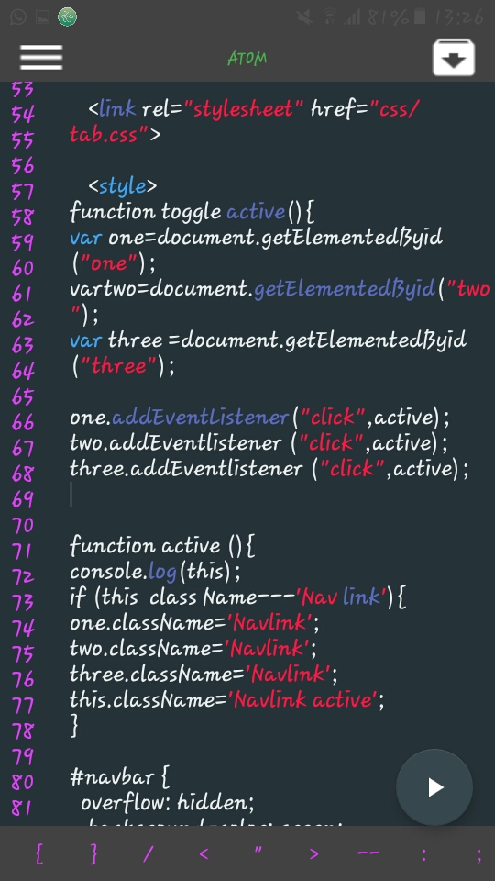
Change colour of navigation bar
I added new class names to the active link
Used if statements
I then created the “active” function.

Slide 3
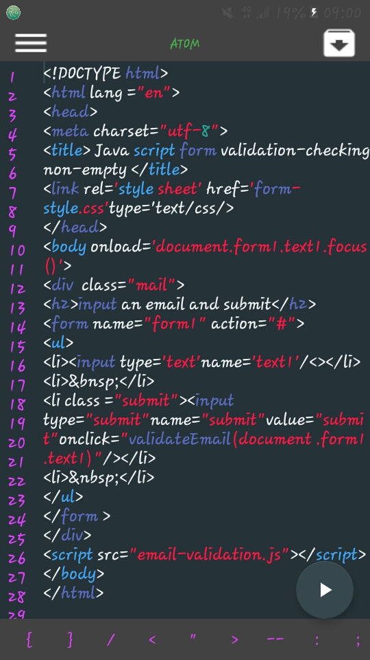
To create a form

Slide 4

Link a form to a website
I also linked my form to the website using this method.The form can now appear on the navigation bar of the website

Slide 5

Insert images
I linked my Images to the website using this method.

